Slide 1



Hardware and Software Fundamentals of Intelligent Computing Systems

Slide 2
Lecture 31: Communication Primitives

Slide 3
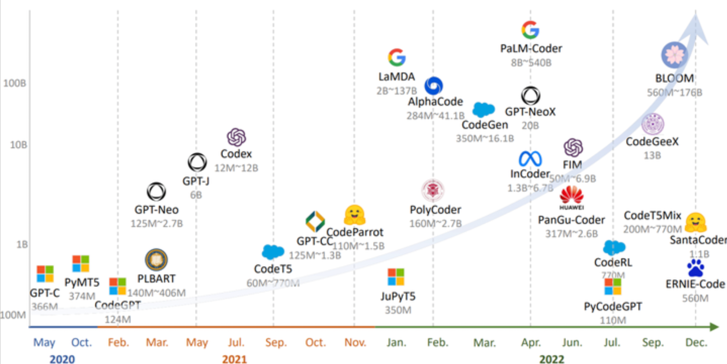
Scaling Law of LLMs
Model performance improves predictably as a power-law function of compute, data size, and parameter count.
NVL576
[1] https://arxiv.org/abs/2001.08361
[2] https://dnacap.fund/insights/exploring-the-landscape-of-large-language-models

Slide 4
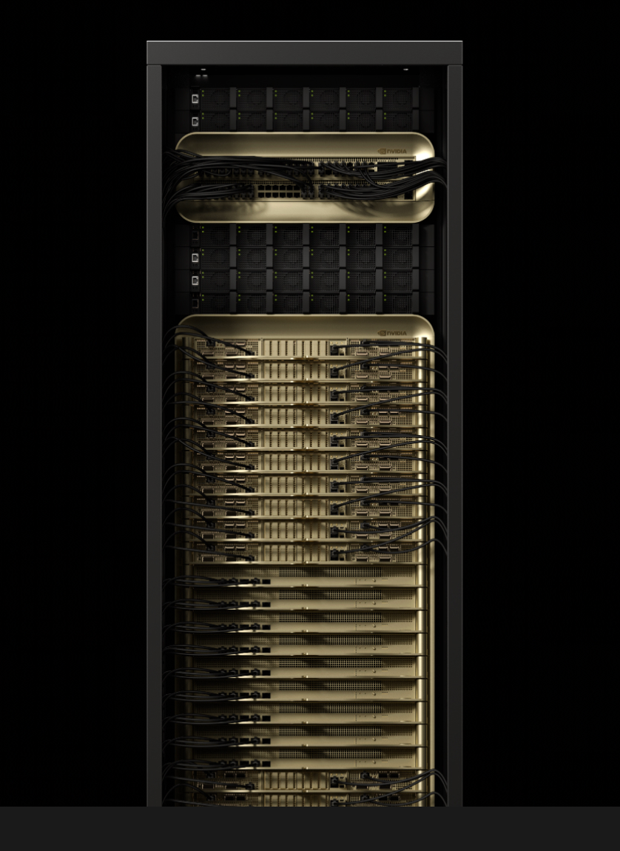
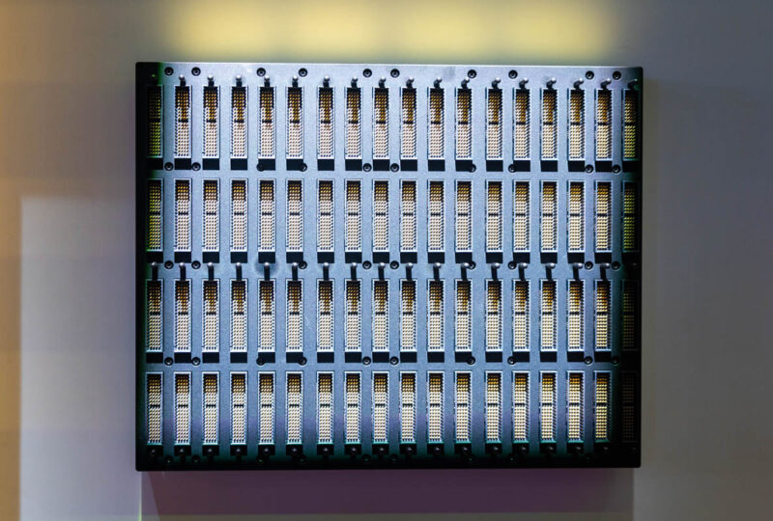


AI computing systems are also scaling
Scale-up supernodes are on the rise…
NVL576
NVL72
Huawei CloudMatrix384
AMD Helios

Slide 5
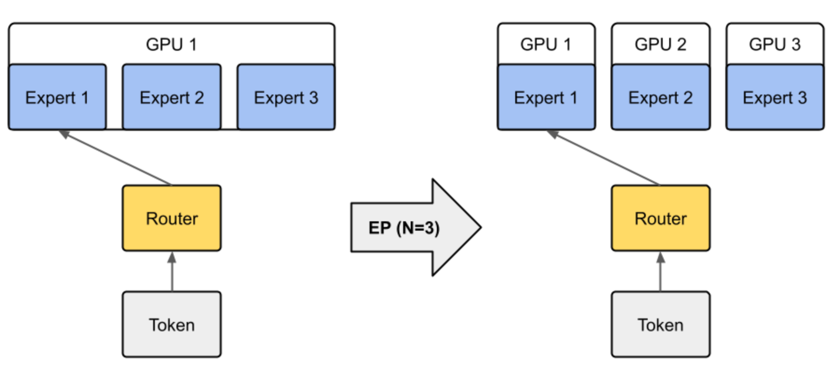
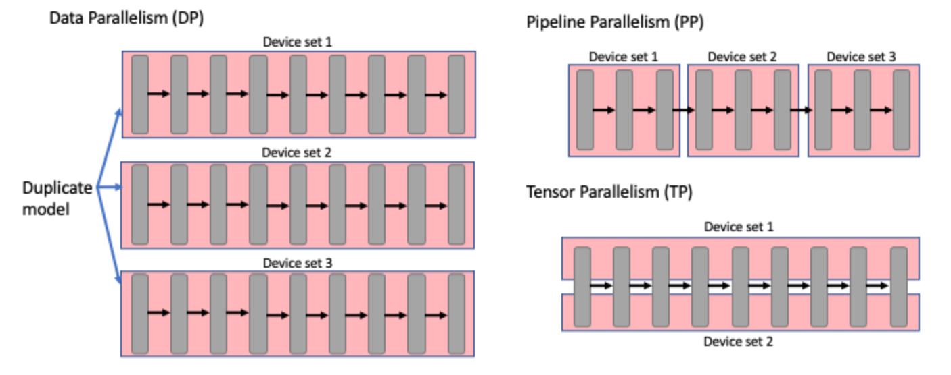
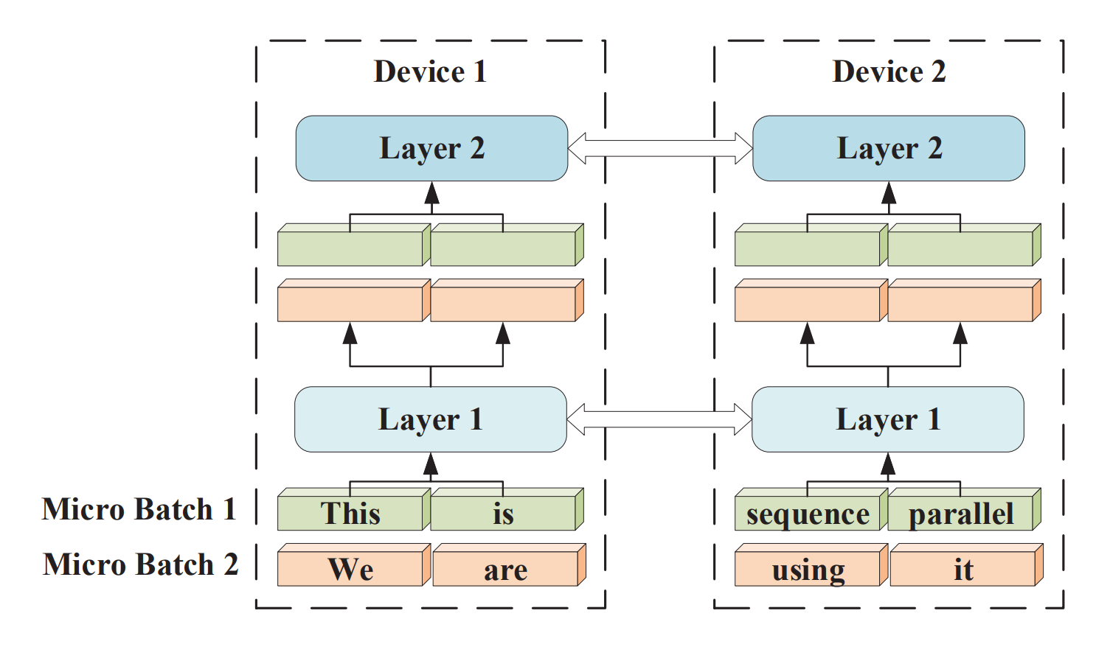
Mapping LLMs on multiple GPUs/NPUs…
Multi-dimension Parallelisms
Expert Parallelism
Sequence Parallelism
[1] https://robotchinwag.com/posts/demystifying-tensor-parallelism/
[2] https://docs.nvidia.com/nemo/megatron-bridge/0.2.0/parallelisms.html
[2] https://aclanthology.org/2023.acl-long.134.pdf

Slide 6
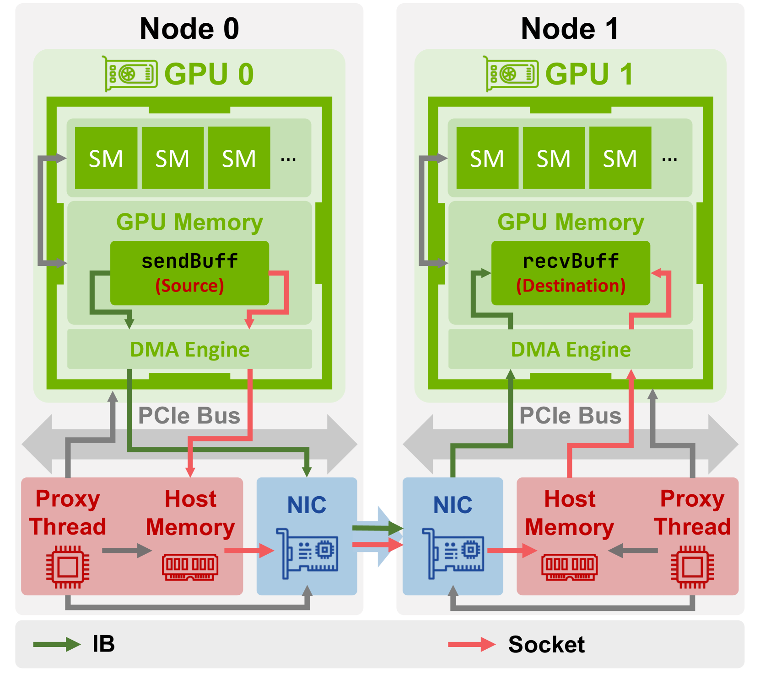
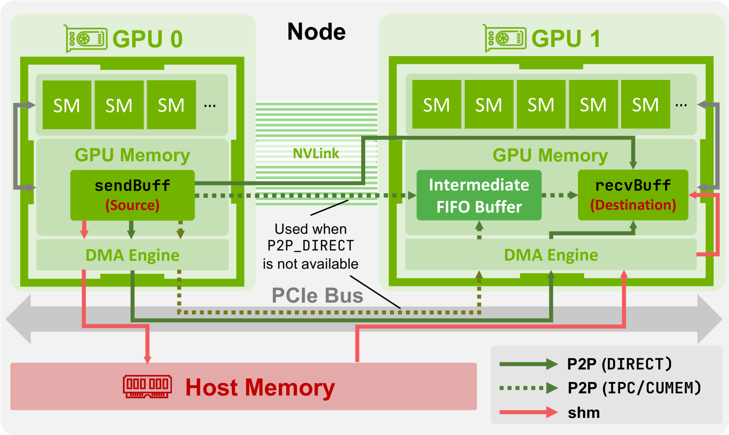
Communication datapath in the AI systems
Scale-up: NVLINK, HCCS, Unified Bus
Scale-out: InifiniBand (IB), RoCE
Intra-node GPU communications via NVLINK or PCIe
Inter-node communications via RDMA NIC (IB)
[1] https://arxiv.org/html/2507.04786v1

Slide 7
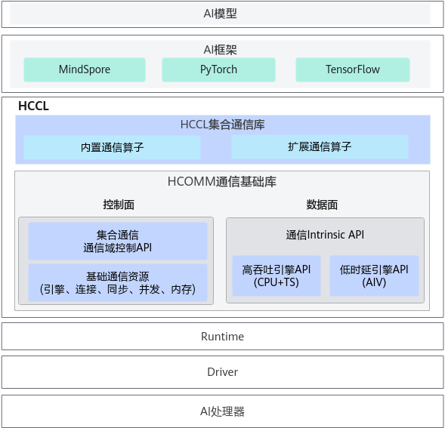
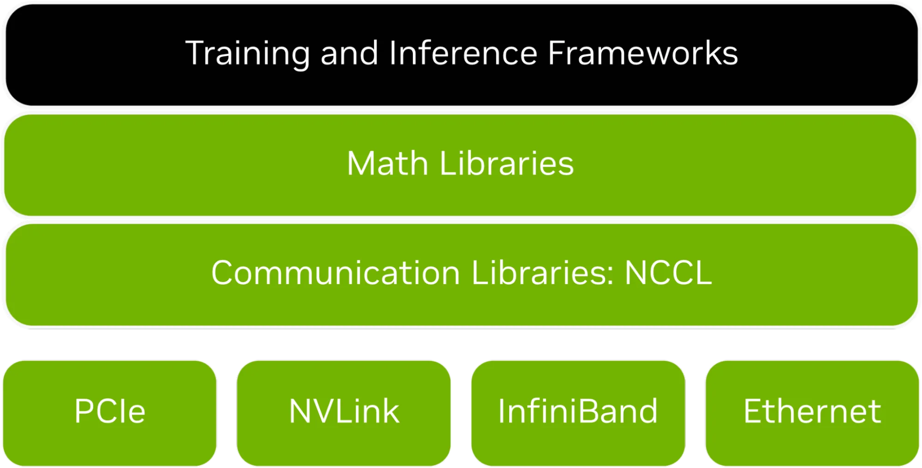
Collective v.s. Point-to-point communications
Collective operations involve communication among a group of processes rather than just between pairs of processes. e.g., AllReduce, AllGather, Broadcast
Point-to-point: Send/Recv (Two-side), Put/Get (One-side)
[1] https://developer.nvidia.com/blog/scaling-ai-inference-performance-and-flexibility-with-nvidia-nvlink-and-nvlink-fusion/
[2] https://www.hiascend.com/developer/techArticles/20240809-1

Slide 8
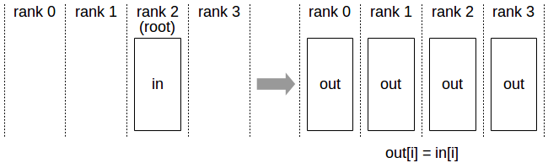
Broadcast
Operations: copy an N-element buffer from the root rank (2) to all the ranks (0-3).
[1] https://docs.nvidia.com/deeplearning/nccl/user-guide/docs/usage/collectives.html

Slide 9
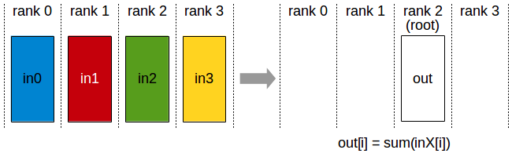
Reduce
Operations: performs reduction on data (for example, sum, min, max) across devices and stores the result in the receive buffer of a specified root rank.
[1] https://docs.nvidia.com/deeplearning/nccl/user-guide/docs/usage/collectives.html

Slide 10
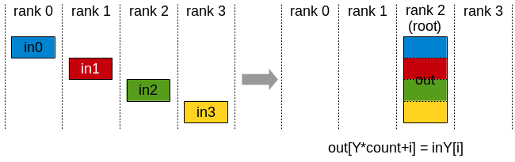
Gather
Operations: gathers N values from k ranks into an output buffer on the root rank of size k*N.
[1] https://docs.nvidia.com/deeplearning/nccl/user-guide/docs/usage/collectives.html

Slide 11
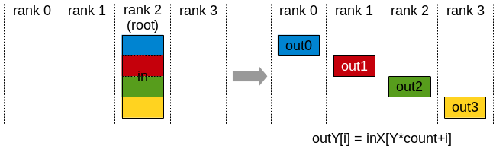
Scatter
Operations: distributes a total of N*k values from the root rank to k ranks, each rank receiving N values.
[1] https://docs.nvidia.com/deeplearning/nccl/user-guide/docs/usage/collectives.html

Slide 12
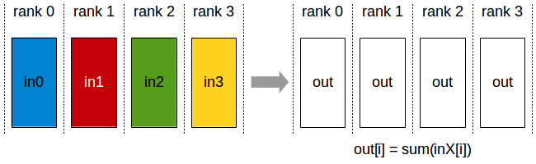
AllReduce
Operations: performs reductions on data (for example, sum, min, max) across devices and stores the result in the receive buffer of every rank.
[1] https://docs.nvidia.com/deeplearning/nccl/user-guide/docs/usage/collectives.html

Slide 13
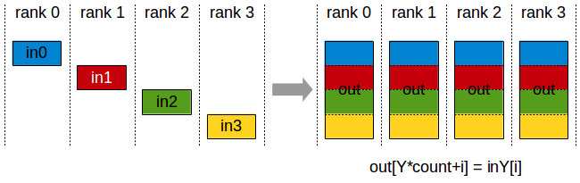
AllGather
Operations: gathers N values from k ranks into an output buffer of size k*N, and distributes that result to all ranks.
The output is ordered by the rank index.
This operation is therefore impacted by a different rank to device mapping.
[1] https://docs.nvidia.com/deeplearning/nccl/user-guide/docs/usage/collectives.html

Slide 14
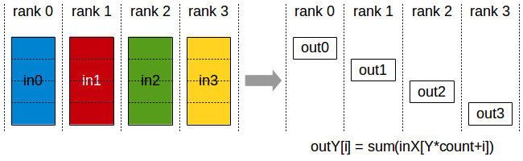
ReduceScatter
Operations: performs the same operation as Reduce, except that the result is scattered in equal-sized blocks between ranks, each rank getting a chunk of data based on its rank index.
This operation is therefore impacted by a different rank to device mapping.
[1] https://docs.nvidia.com/deeplearning/nccl/user-guide/docs/usage/collectives.html

Slide 15
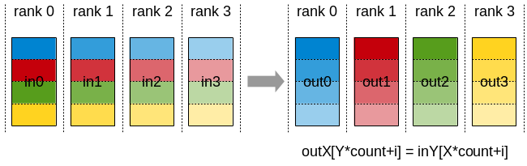
AlltoAll
Operations: each rank provides an input buffer of size N values, where the j-th chunk of N/k values is sent to destination rank j. Each rank receives an output buffer of size N values, where the i-th chunk of N/k values comes from source rank i.
[1] https://docs.nvidia.com/deeplearning/nccl/user-guide/docs/usage/collectives.html

Slide 16
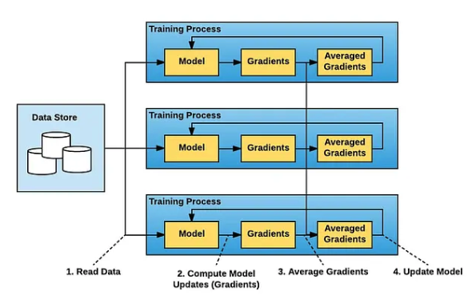
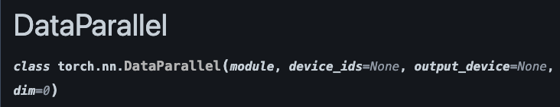
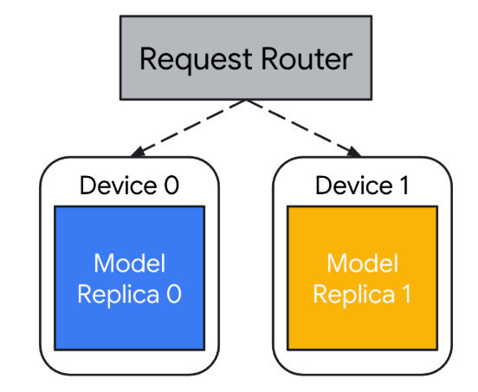
Take FSDP (PyTorch) as an example
DP, DDP, FSDP: Data Parallelism, Distributed DP, Fully Sharded DP
What is DP: multiple model copies on different devices.
Inference is simple.
[1] https://www.uber.com/en-JP/blog/horovod/
All-reduce operators
Notes:
单击此处添加文本

Slide 17
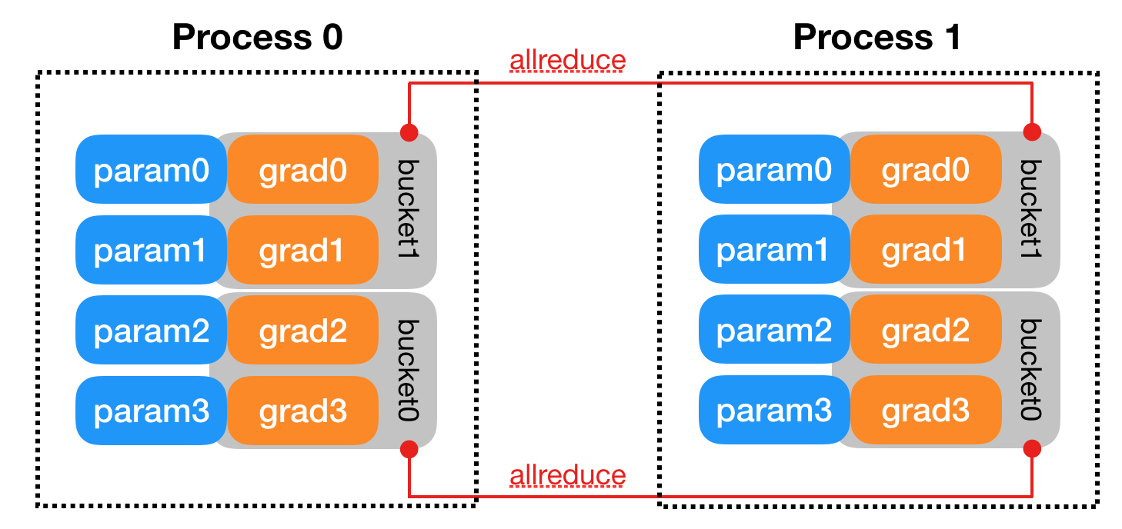
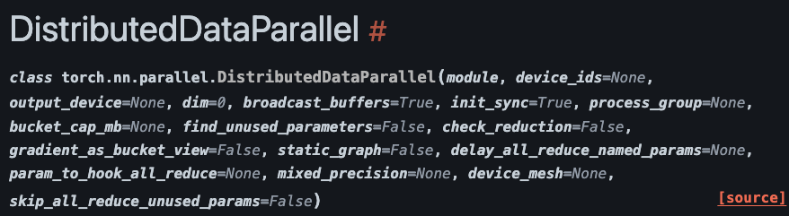
Take FSDP (PyTorch) as an example
DP, DDP, FSDP: Data Parallelism, Distributed DP, Fully Sharded DP
DDP is recommended: optimized all-reduce (ring-based) + distributed support
DP: reduce op is executed on node 0 (imbalance); DDP: ring-based all-reduce.
DDP: robust multi-process support.
[1] https://docs.pytorch.org/docs/stable/notes/ddp.html
Notes:
DP 线程同步开销比较大；单进程多线程；all-reduce是汇聚到0卡上算，不均衡；不支持多机

Slide 18
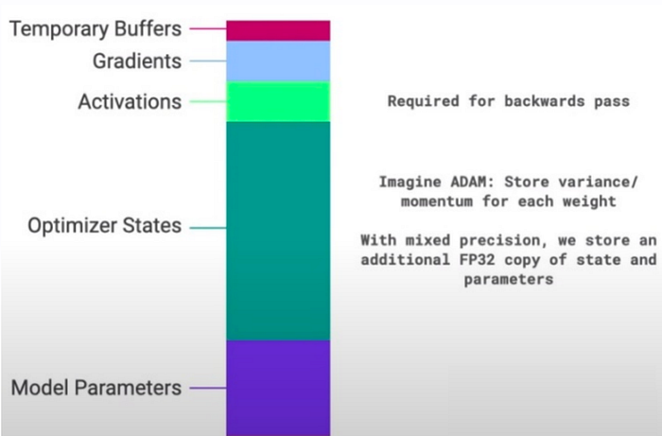
Take FSDP (PyTorch) as an example
DP, DDP, FSDP: Data Parallelism, Distributed DP, Fully Sharded DP
Before FSDP, we profile the memory utilization during the LLM training.
Model params account for only a portion of the
total memory consumption during training.
We need to consider the optimizer states and
gradients.
Core Idea: removing redundant data.
ZeRO (Zero Redundancy Optimizer).
[1] https://docs.pytorch.org/docs/stable/notes/ddp.html
Notes:
DP 线程同步开销比较大；单进程多线程；all-reduce是汇聚到0卡上算，不均衡；不支持多机

Slide 19
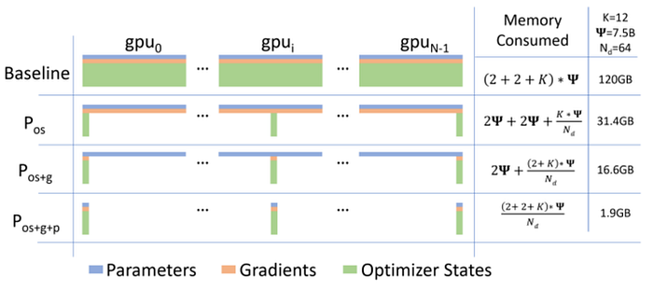
Take FSDP (PyTorch) as an example
DP, DDP, FSDP: Data Parallelism, Distributed DP, Fully Sharded DP
ZeRO with different opt levels:
ZeRO-1: Shards the optimizer states (Optimizer States Sharding).
ZeRO-2: Shards both optimizer states and gradients (Optimizer States & Gradients Sharding).
ZeRO-3: Shards the optimizer states, gradients, and model parameters (Optimizer States & Gradients & Parameters Sharding).
ZeRO3 will introduce the extra communications because of the partitions of model parameters.
K denotes the memory multiplier of the optimizer states
[1] https://docs.pytorch.org/docs/stable/notes/ddp.html
[2] https://www.youtube.com/watch?v=czgA-MbAdvA&t=2550s
Notes:
略过过程，直接到结论，Zero1和2的通信量和普通DP一样，每张卡都是2倍的参数量；
标准DP：用ReduceScatter和Allgather两步完成all-reduce，正好是二倍的参数量。
Zero1: 先用 ReduceScatter 把梯度 Reduce 到不同显卡上，每个显卡有一份平均后的 Gradient （这里的一份代表的是每个 Device 有一小份平均后的 Gradient），利用这个 Gradient 更新 Optimizer 和参数，再把更新后的模型参数通过 AllGather 分发到所有显卡上，整体来看跟原来的DP保持一致。
Zero2: Zero1相当于白存了很多gradient？所以每次发过去gradient就可以；也是2倍参数量；
Zero3: 在Zero2的基础上再切参数；增加了一次参数all-gather的参数量;

Slide 20
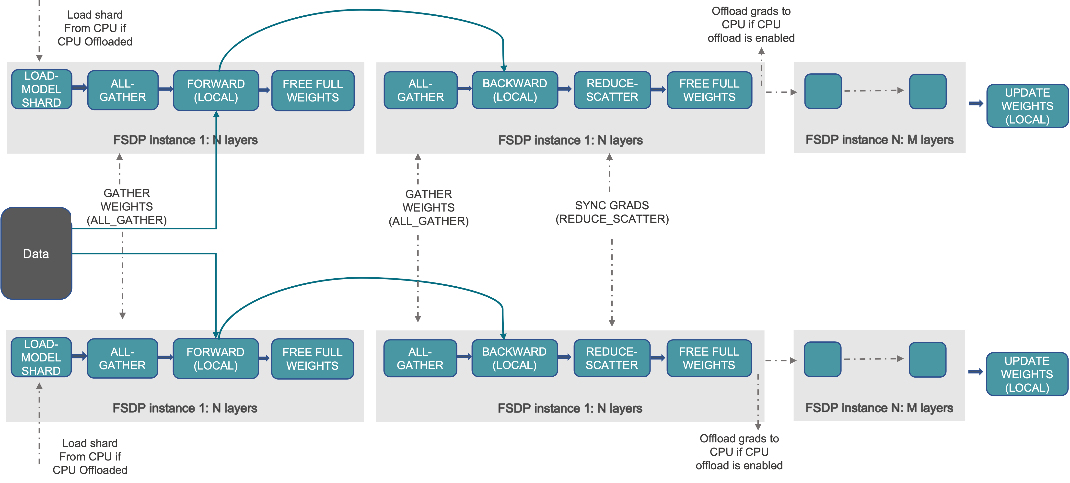
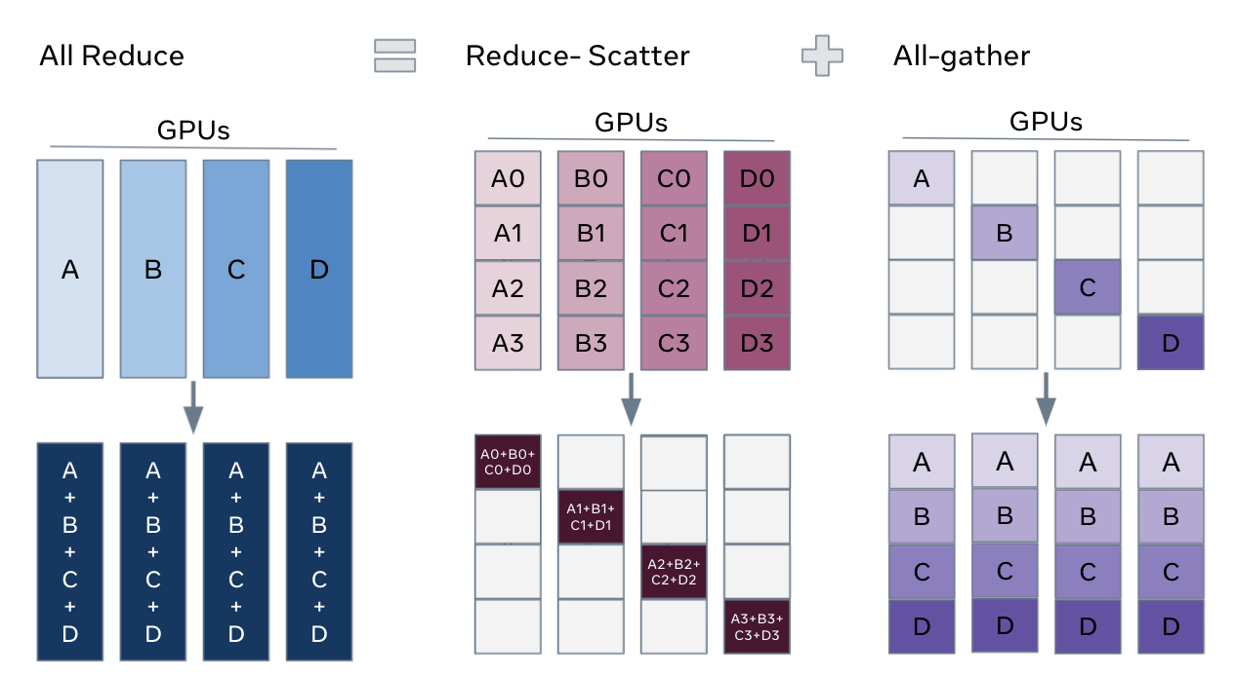
Take FSDP (PyTorch) as an example
DP, DDP, FSDP: Data Parallelism, Distributed DP, Fully Sharded DP
FSDP: sharding model parameters/gradient/optimizer states for GPU memory reduction (ZeRO3).
All-reduce =
Reduce-scatter + all-gather
[1] https://docs.pytorch.org/tutorials/intermediate/FSDP_tutorial.html
[2] https://arxiv.org/abs/2304.11277
Notes:
还是以数据并行度2为例，假设batchsize为1024，FSDP步骤如下：
数据并行将数据拆分为2个512小batch，并送到两张卡的训练进程上
两个进程各自维护模型的一部分参数，利用自己的512数据进行前向和反向
模型前向时需要执行all_gather操作，以使每个进程拿到所有权重
模型反向时也需要执行all_gather拿到权重，以及reduce_scatter同步进程间的梯度
当内存不足时，FSDP还支持将梯度卸载到CPU上
最后使用同步后的梯度更新各自进程上的模型参数

Slide 21
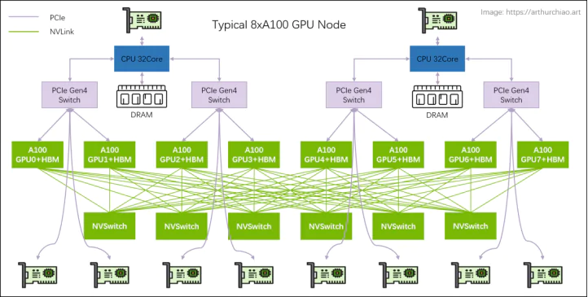
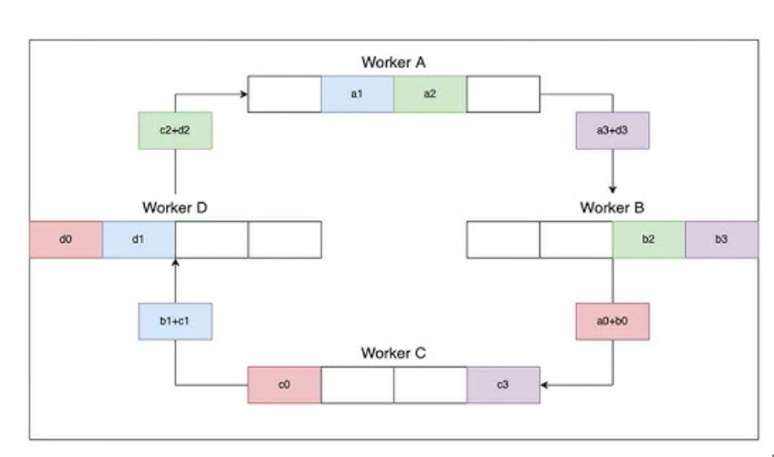
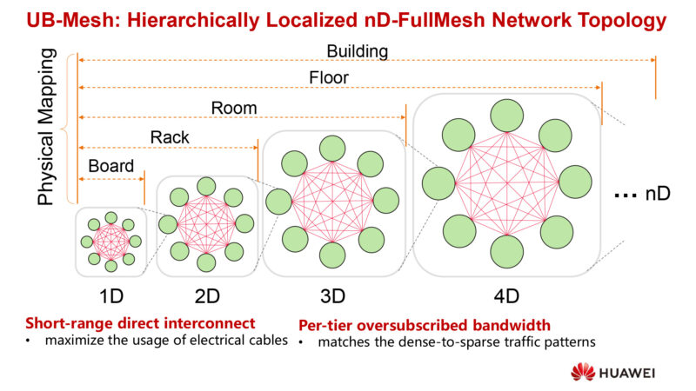
Implementations of collective communication op.s
All-reduce = Reduce-scatter + all-gather
The implementations
highly depends on
the hardware topology
NVIDIA GPU CLOS Topology
Ring All-reduce
HUAWEI NPU Full-mesh Topology
[1] https://docs.pytorch.org/tutorials/intermediate/FSDP_tutorial.html
[2] https://arxiv.org/abs/2304.11277
Notes:
还是以数据并行度2为例，假设batchsize为1024，FSDP步骤如下：
数据并行将数据拆分为2个512小batch，并送到两张卡的训练进程上
两个进程各自维护模型的一部分参数，利用自己的512数据进行前向和反向
模型前向时需要执行all_gather操作，以使每个进程拿到所有权重
模型反向时也需要执行all_gather拿到权重，以及reduce_scatter同步进程间的梯度
当内存不足时，FSDP还支持将梯度卸载到CPU上
最后使用同步后的梯度更新各自进程上的模型参数

Slide 22

The Solution: FlagOS, a Unified AI Software Stack

Slide 23








https://space.bilibili.com/3546791834290849
https://github.com/flagos-ai
https://www.zhihu.com/people/95-22-20-18/posts
https://flagos.io/Home

Slide 24

Thanks for your time！

